Slide 1
CASE STUDY Credit EDA Assignment BANK LOAN Request Validation
Rupali Pal

Slide 2
Problem Synopsis
The clients in this dataset are those who applied for bank loans.
The "TARGET" column in this dataset indicates which clients are having payment issues.
This dataset will be analyzed, and factors that aid in identifying defaulters and satisfied consumers will be determined.
Banks prefer to give loads to loyal clients rather than to defaulting borrowers.
The loan approval and rejection history of the previous application dataset will be analyzed to determine which category of consumers received a loan in the past and shouldn't get one now because they have defaulted or failed to make their payments on time.

Slide 3
Goal
Analyze the datasets using the EDA procedure.
The user is likely to have payment troubles or default on the loan. This can be determined by looking for patterns, insights, and variables.
User promises to make on-time installment payments.
•The bank can use the insights from these datasets to detect defaulters in order to reduce business losses and to acquire business from good customers.

Slide 4
Data Interpretation
Understanding of Data
• There are three files.
• application_data.csv: This is a dataset of clients' most recent loan applications.
The dataset previous_applidation.csv contains details about prior applications, including whether they were accepted, denied, or unused.
• columns_description.csv: This data dictionary contains details on every column in the two files previously mentioned.

Slide 5
Technique
• Cleansing the data;
• Removing columns that had more than 40% eliminated.
• Next, unnecessary columns were found and removed.
• Treatment of Missing values
• In the event of missing data, category type columns are imputed with the mode.
• When a value is missing, the median is imputed to numerical columns.
• Outlier Treatment: In numerical column types, outliers are substituted with the upper or lower limit values.
• Data standardization; • Column types are changed to object/category values with fewer unique values, such as flag type values with 1,0, which are comparable to True and False.
• The fields' binned
• A few columns, such as org type, with several values are grouped together in a same category.

Slide 6
Data Analysis
• Univariate analysis
• Used count plot in loops to check frequency distribution of categorical variables.
• Used box plot to see distribution of numerical variables
• Bivariate Analysis
• Used pair plot for numerical values relational distribution
• Used bar graph for by grouping on categorical variable and aggregating numerical
variable
• For both categorical variables
• Create barplot with hue of TARGET variable to see which category has payment
difficulties more.
• Multivariate Analysis
• Used heat map by creating pivot table for 2 columns and aggregating target on the

Slide 7
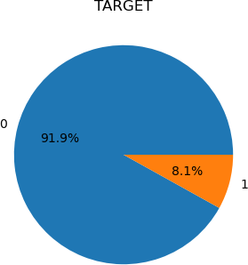
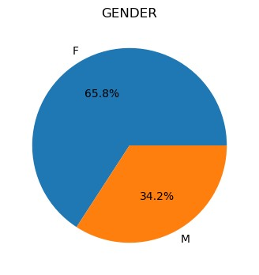
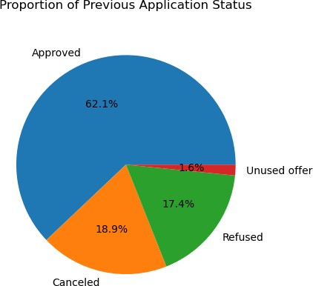
OBSERVATIONS
Only 8% of customers are displayed as defaulters in the target data, which is unbalanced.
• 65% of male and 35% of female loan applicants, respectively, are ratios.
• Previous application data shows that roughly 62% of applications are accepted, with 18% and 17% being canceled and declined, respectively.

Slide 8
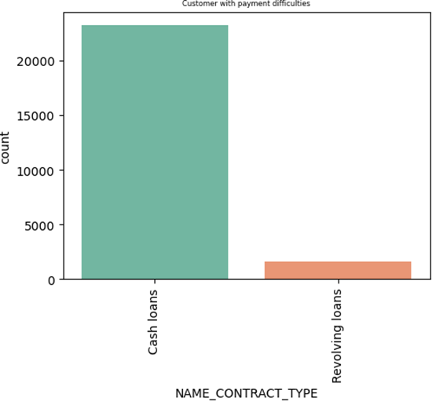
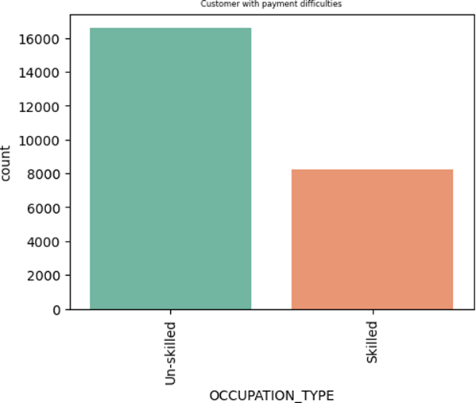
• Loans in cash Compared to borrowers with revolving loans, contract type clients default more frequently.
When compared to skilled clients, untrained occupational type clients default more frequently.

Slide 9
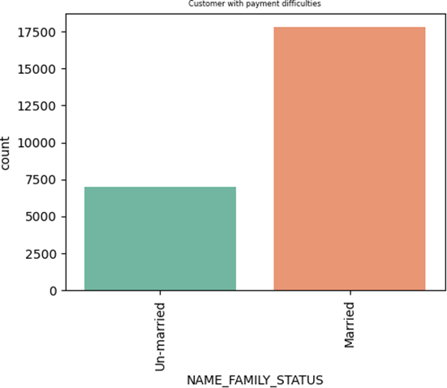
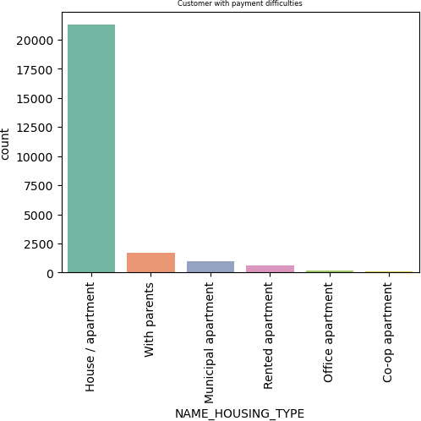
• Clients who own a house or flat are defaulting more frequently than clients in other categories.
• Married clients default more frequently than unmarried clients.

Slide 10
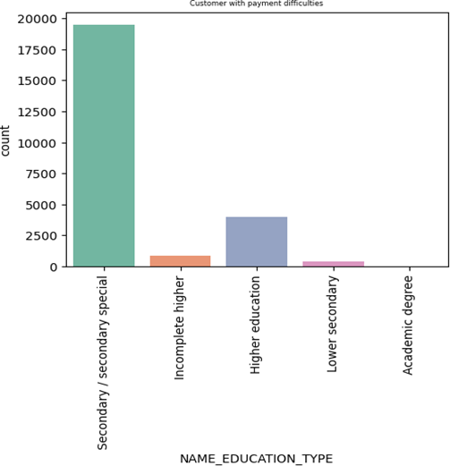
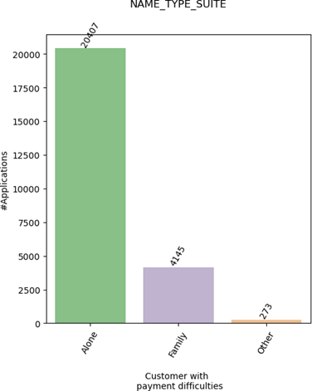
OBSERVATIONS
.
Clients with secondary education are the most likely to experience payment troubles.
Loan applications submitted by unaccompanied applicants result in higher default rates than those submitted by family members or other visitors

Slide 11
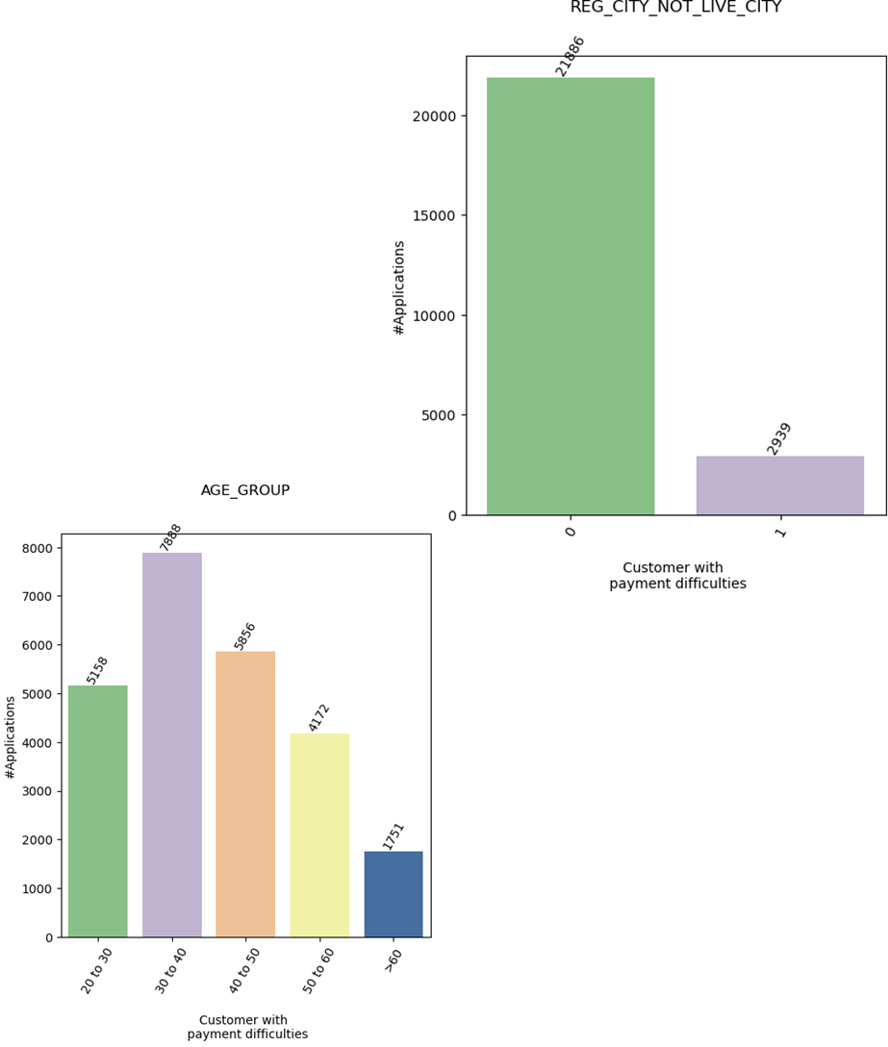
OBSERVATIONS
There are more defaults from clients whose live city differs from their reg city.
• Clients in the 30- to 40-year-old age range are experiencing greater payment challenges.

Slide 12
Conclusion
Elements that point to a potential debt default
• Education level: Those with lower levels of education have a higher chance of loan default.
• Occupation: People with less steady employment, those without a job, and unskilled laborers are more prone to default.
• Loan default is more likely to occur among applicants who have more defaulters in their social network.
• Loan history: Applicants who have had prior loan denials or cancellations are more likely to experience loan default.
• Loan frequency: Recurring borrowers have a higher chance of defaulting.

Slide 13


